Slide 1
HR Maturity Assessment Project
Team RAIse (Readiness for AI Strategy and Enablement)
04-07-2025

Slide 2
AGENDA
1
Project Overview
2
Solution & Highlights
3
Impact & Learnings
4
Collage of the team

Slide 3
Project Overview
Challenge Introduction: Identifying HR maturity gaps in organizations
Problem Statement & Objectives:
• Lack of HR maturity understanding limits, strategic HR growth
• Need a tool to assess HR maturity and offer insights
• Objective: Provide a HR Maturity Score with actionable AI-generated feedback
Technologies/Tools Used:
• Frontend: Next.js, TypeScript, Tailwind CSS
• Backend: Node.js, Express.js, Lab45 AI

Slide 4

Key Features
• HR maturity questionnaire and score​
• AI-driven insights and industry benchmarking​
• Interactive results dashboard​
Innovations
Solution & Highlights
• Integrated Lab45 AI for personalized recommendations​
• Full-stack JS ecosystem for speed and compatibility​
• Visual data via Chart.js
Outcomes
• Efficient assessments
• Strategic HR development insights

Slide 5
Impact & Learnings
Challenges & Solutions:
• JSON data handling — resolved via JS stack
• AI integration — explored and adapted Lab45 API
• UI consistency — Tailwind ensured design alignment
Key Learnings:
• AI integration in business applications
• Real-time feedback and improvement loops
Future Scope:
• Enhanced user management & Authentication
• Interactive & Insightful visualization
• Customization & Advanced automation

Slide 6


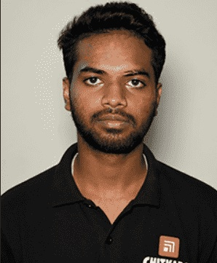

Meet the team
Aditya Raj Sahoo
Rohit Raj
Jayant Mehta
Developer
Developer
Analyst

Slide 7
Thank you.

